Slide 1
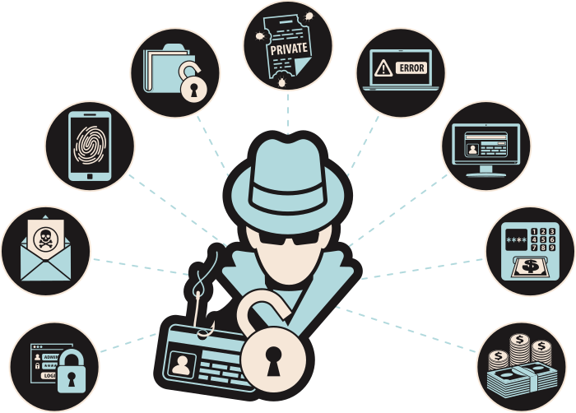
PHISHING AWARENESS TRAINING
Think Before You Click!
- OM BARVALIYA

Slide 2
OBJECTIVES
By the end of this lesson, students will be able to:
1
2
3
Define phishing and identify common methods used by scammers
Recognize red flags in phishing emails, messages, or posts
Develop critical thinking skills to discern legitimate requests from potential phishing attempts

Slide 3
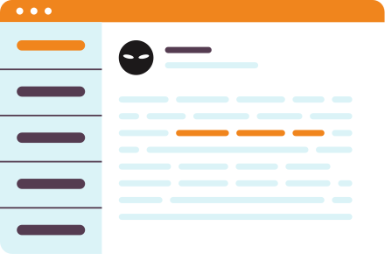
WHAT IS PHISHING?
Phishing is a fraudulent attempt to obtain sensitive information by disguising as a trustworthy entity.
Attackers often use email, phone, or text messages.
Data targeted: passwords, credit card numbers, social security numbers, login credentials.
Think of an email or message you received that asked for personal information. What made it suspicious?

Slide 4



TYPES OF PHISHING
Phishing attacks come in different forms
EMAIL PHISHING
SPEAR PHISHING
WHALINGING
Scammers send fake emails pretending to be a trustworthy organization
Tailored to a specific target with personal information.
Targets high-profile executives with custom attacks.

Slide 5


TYPES OF PHISHING
Phishing attacks come in different forms
SMISHING
VISHING
Phishing via SMS (e.g., fake delivery messages)
Voice phishing, often pretending to be tech support or banks.

Slide 6

RED FLAGS
Red flags in phishing attempts are warning signs or indicators that help individuals identify potential scams. Some common read flags in phishing include:
1
Urgent or threatening language
2
Suspicious sender information
3
Requests for personal information
4
Misspellings or grammatical errors
5
Suspicious links or attachments
6
Generic greetings
7
Too good to be true

Slide 7

01
URGENT OR THREATENING LANGUAGE
03
REQUESTS FOR PERSONAL INFORMATION
Phishing attempts often create a sense of urgency or use threatening language to prompt immediate action. Phases like "urgent action required," "account suspended," or "your account will be deleted" may indicate a phishing attempt.
Legitimate organizations do not request personal information, such as usernames, passwords, or credit card numbers, via email, social media, or other online means. Be cautious of any request for personal information.
02
SUSPICIOUS SENDER INFORMATION
04
MISSPELLINGS OR GRAMMATICAL ERRORS
Check the sender's email address or social media profile. Phishing emails or messages often use generic or suspicious email addresses that do not match the legitimate entity they claim to represent.
Phishing emails or messages may contain misspellings, grammatical errors, or awkward phrasing. Legitimate organizations usually have professional communications and do not contain obvious errors.

Slide 8
05
SUSPICIOUS LINKS OR ATTACHMENTS
07
TOO GOOD TO BE TRUE
Be cautious of links or attachments in emails or messages from unknown or untrusted sources. Hover over links to check their actual destinations, and do not click on suspicious links or download attachments that you were not expecting.
Phishing attempts may lure individuals with enticing offers, such as winning a prize or getting a huge discount. If an offer seems too good to be true, it may be a phishing attempt.
06
GENERIC GREETINGS
Which of the seven red flags do you think is the hardest to detect? What makes you say that?
Phishing emails may use generic greetings like "Dear Customer" instead of addressing you by your name. Legitimate organizations often personalize their communications with your name or other relevant information.

Slide 9

RECOGNIZING PHISHING WEBSITES
1
Check for HTTPS and lock icon.
2
Look for misspelled URLs or fake subdomains.
3
Be wary of websites that ask for excessive information.
4
Use bookmarked or official URLs, not links from unknown emails.

Slide 10
CONSIDER THESE RED FLAGS
EXAMPLE 1
You come across a pop-up window while browsing a website that asks you for your credit card information to claim a prize or discount within the next 10 minutes. The website looks legitimate, but you only have 10 minutes to submit your personal information.
EXAMPLE 2
Read the examples and then identify which form of phishing it is and what red flags make it a phishing attempt.
You receive a message on social media from someone claiming to be a friend or family member, asking for your address and phone number. You've never met this person and don't see photos of them with your family or friends.

Slide 11

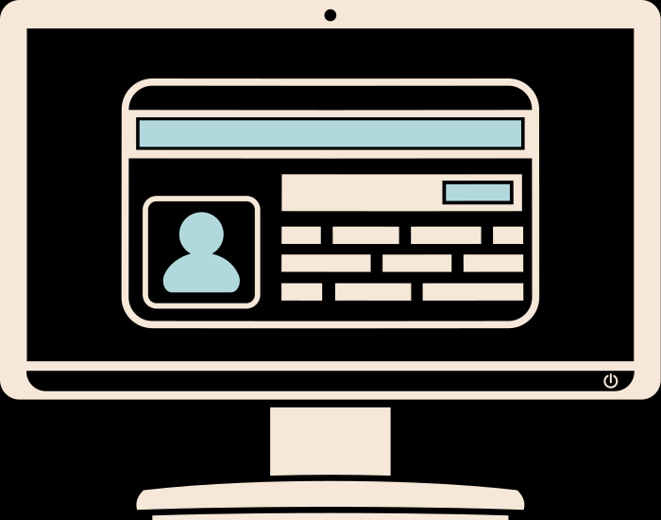
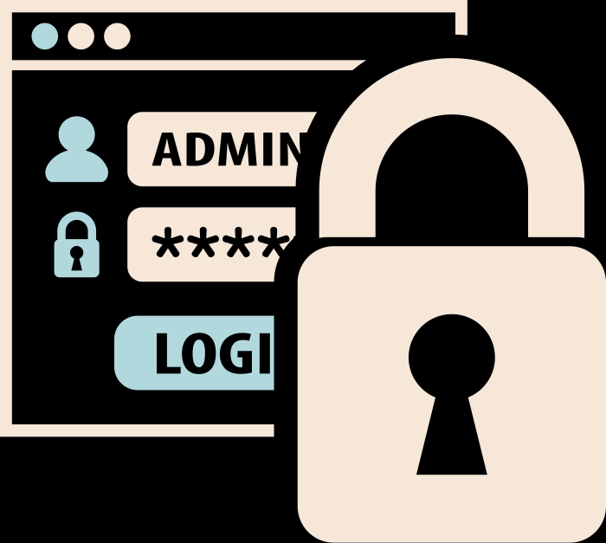
PREVENTIVE MEASURES
Be skeptical of emails, messages, or posts that seem too good to be true or too urgent. Remember, if it sounds too good to be true, it probably is!
Think before clicking on any links, sharing personal information online, or opening any suspicious attachments. Ask yourself if it seems legitimate and if you were expecting it.
Verify the authenticity of the sender and the information provided before taking any action. Trust your instincts and be cautious when sharing information online.

Slide 12

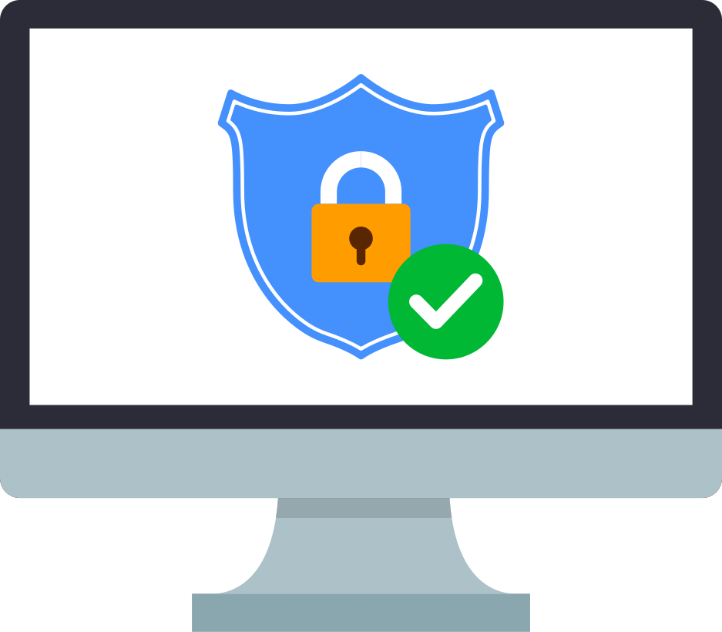
PREVENTIVE MEASURES
Use updated antivirus software with real-time protection and configure firewalls to monitor inbound and outbound traffic.
Enable advanced email filters and spam detection systems to identify and block phishing links and spoofed domains.
Regularly install operating system and application patches to fix security vulnerabilities.
Enable automatic updates and monitor for critical security advisories from trusted vendors.

Slide 13



TOOLS & RESOURCES
Google Safe Browsing:
Check if a website is safe.
Have I Been Pwned:
See if your email/data has been leaked.
Stay Safe Online:
Cybersecurity resources.

Slide 14

SUMMARY & KEY TAKEAWAYS
1
Always verify communications.
2
Never trust unsolicited emails or links.
3
Be cautious and report suspicious activity.
4
Keep learning - phishing tactics evolve.

Slide 15
THINK BEFORE YOU CLICK!
PROTECT YOURSELF FROM PHISHING
Don't share your personal information online!

